Slide 1



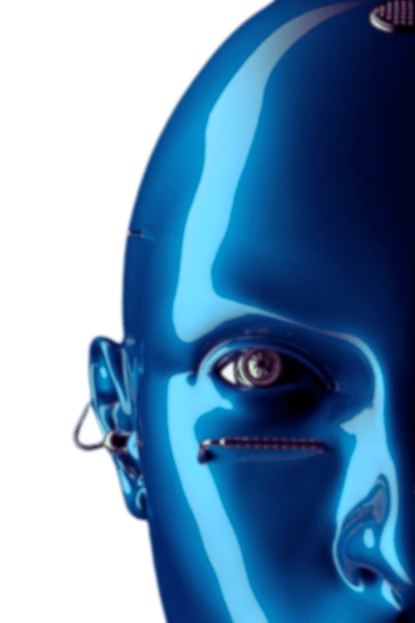

K.A.M.A.L.A
Kapidhwaj Association of Modern logic, Automation, Learning and career Advancement
PROBLEM STATEMENT
(HEADING)
Your Proposed Solution (Sub heading)
PRESENTED BY:
PRESENTED TO:
Anurag Salpe
Your Name
Ai Agents Workshop - Mini Hackathon
Kapidhwaj Innovations Pvt Ltd

Slide 2
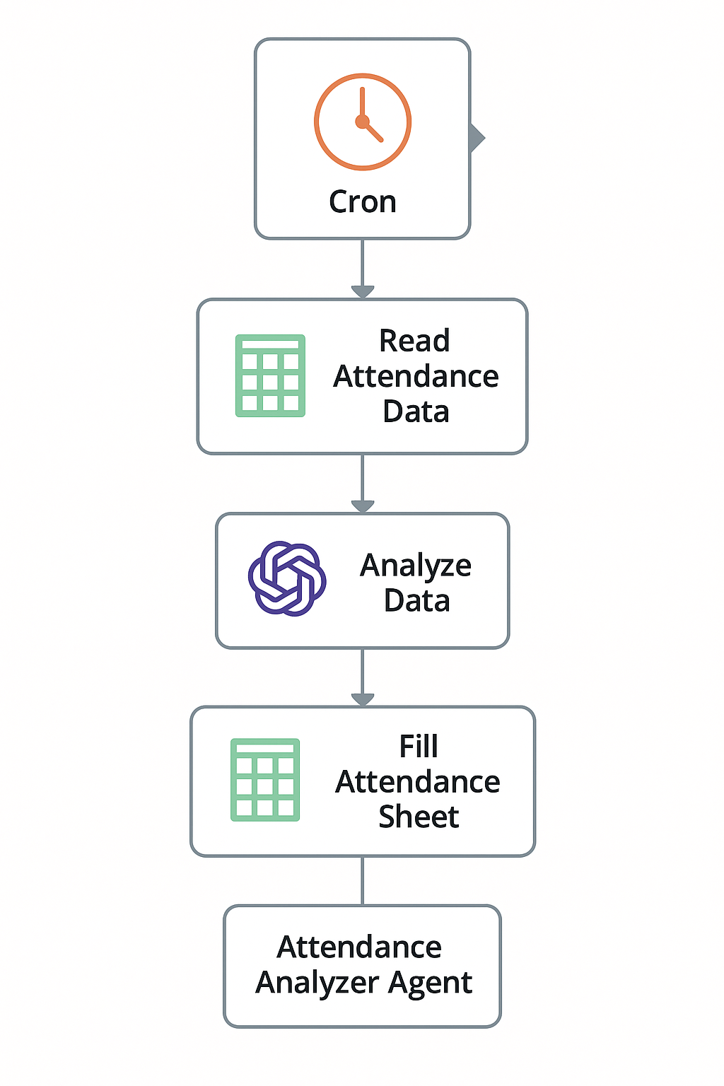

K.A.M.A.L.A
Kapidhwaj Association of Modern logic, Automation, Learning and career Advancement
WORKFLOW DIAGRAM

Slide 3
K.A.M.A.L.A
Kapidhwaj Association of Modern logic, Automation, Learning and career Advancement
USE CASE
Primary Use Cases
Educational Institutions Daily student attendance tracking using biometric data, RFID, or Google Forms. Automatically classify students as Present, Late, or Absent.Teachers no longer have to mark or analyze manually.
Corporate/HR DepartmentsAutomate employee attendance monitoring from swipe card or login/logout logs. Flag habitual latecomers or absenteeism.Feed into HR analytics and payroll systems.
Remote/Hybrid WorkplacesTrack attendance from virtual tools (like Zoom/Teams logs, login records).Automatically update HR sheets with attendance status.Use AI to understand context (e.g., if a meeting was joined on time).
Workshop/Event ManagementManage attendee logs from check-in apps.Automatically classify and send certificates only to fully attended participants.Useful for webinars, tech fests, training programs, etc.

Slide 4
K.A.M.A.L.A
Kapidhwaj Association of Modern logic, Automation, Learning and career Advancement
ADVANTAGES
100% Automation (Zero Human Intervention)No manual entry or checking required. Saves significant time and effort for teachers, HR, or admins.
2. AI-Based Smart Classification Uses AI to handle exceptions and edge cases (e.g., late logins, missing data).Makes consistent and intelligent decisions.
3. Real-Time Updates Attendance status is updated instantly in Google Sheets or dashboards . Helps in live monitoring of presence or absence.
4. Scalable and Flexible Works across domains—education, corporate, events, fieldwork, etc . Can be scaled for thousands of users using cloud infrastructure.
5. Cloud Integration Syncs seamlessly with Google Workspace, Microsoft 365, Zoom, biometric devices, etc . Works from anywhere, any device.

Slide 5
K.A.M.A.L.A
Kapidhwaj Association of Modern logic, Automation, Learning and career Advancement
FUTURE SCOPE
1.Behavioral Analytics & Pattern Detection Predict absenteeism trends. Spot performance dips linked to attendance patterns.
2. Face Recognition Integration Combine with computer vision to track attendance via webcam or CCTV. Fully contactless + real-time classification.
3. Biometric + AI Fusion Use fingerprint or retina scans with AI for multi-factor verification. Increase security and fraud prevention.
4. Conversational Dashboards Use a chatbot to ask: “Who was absent yesterday?” or “Give me a report of latecomers this week.”
5. HR/Payroll Integration Connect with payroll systems to automatically calculate salaries based on attendance.

